Slide 1

















Sizes
140х140 мм
Calculation of the cost of cutting parts according to the drawing
Cut length
0,812 м
90±0,5
140±0,5
70±0,5
Price per item, eur
138,84 eur
90±0,5
+31640053622
Cutl.online
info@cutl.online

Slide 2

cutl.pro
02
CUTL — online service for quick calculation of the cost of manufacturing parts based on DXF drawings
SUITABLE FOR
Laser
cutting
Waterjet
cutting
Plasma
cutting
Any flat
cutting
SUITABLE FOR
Managers
Engineers
Suppliers
Price calculation
Estimate price after development
Preliminary budget assessment during procurement

Slide 3











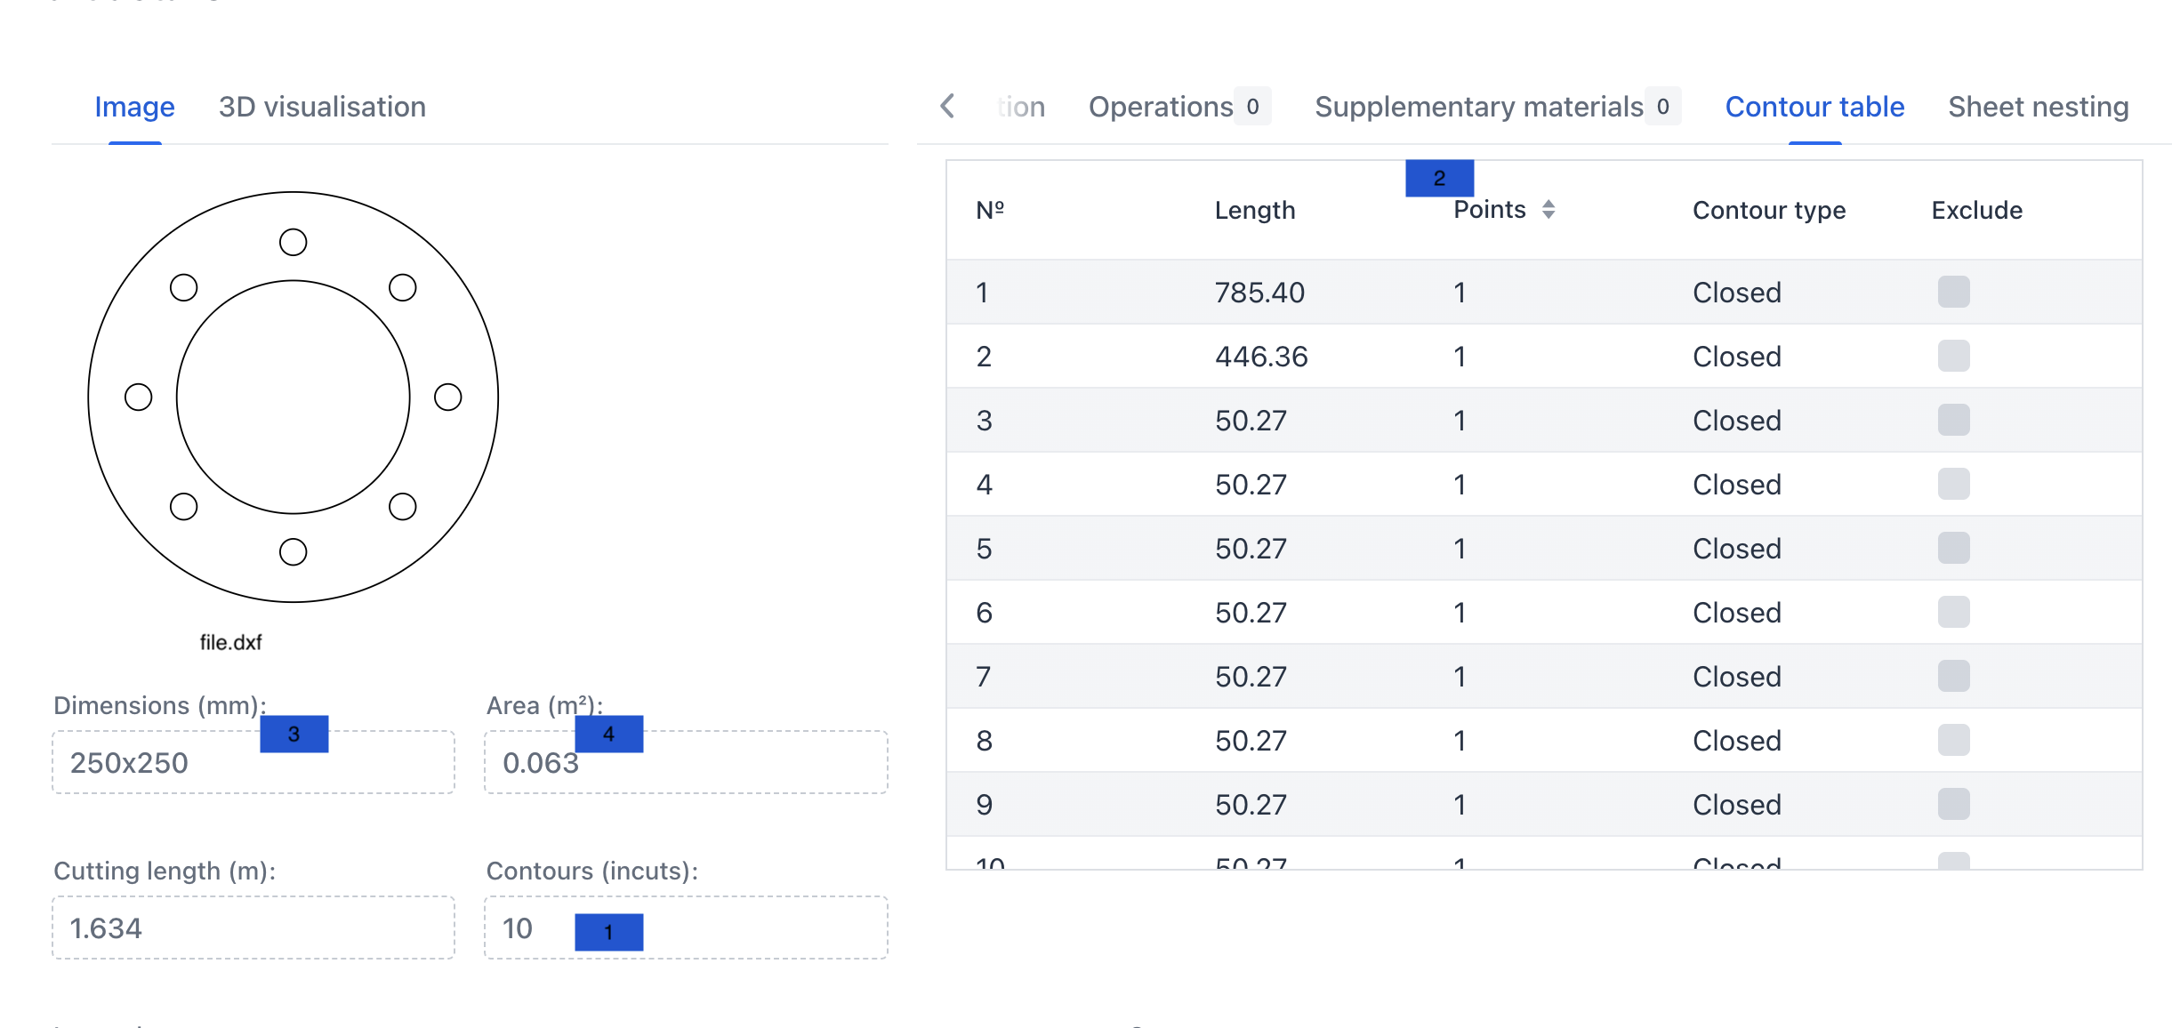






cutl.pro
03
Features
How service works
Upload DXF drawing
DXF analysis
Cost estimation after analysis
2
What CUTL gets after DXF-file analysis
3
4
1
Amount of contours (incuts)
1
2
Length of each contour
3
Size and area of the part
4
Area of the part (without incuts)

Slide 4
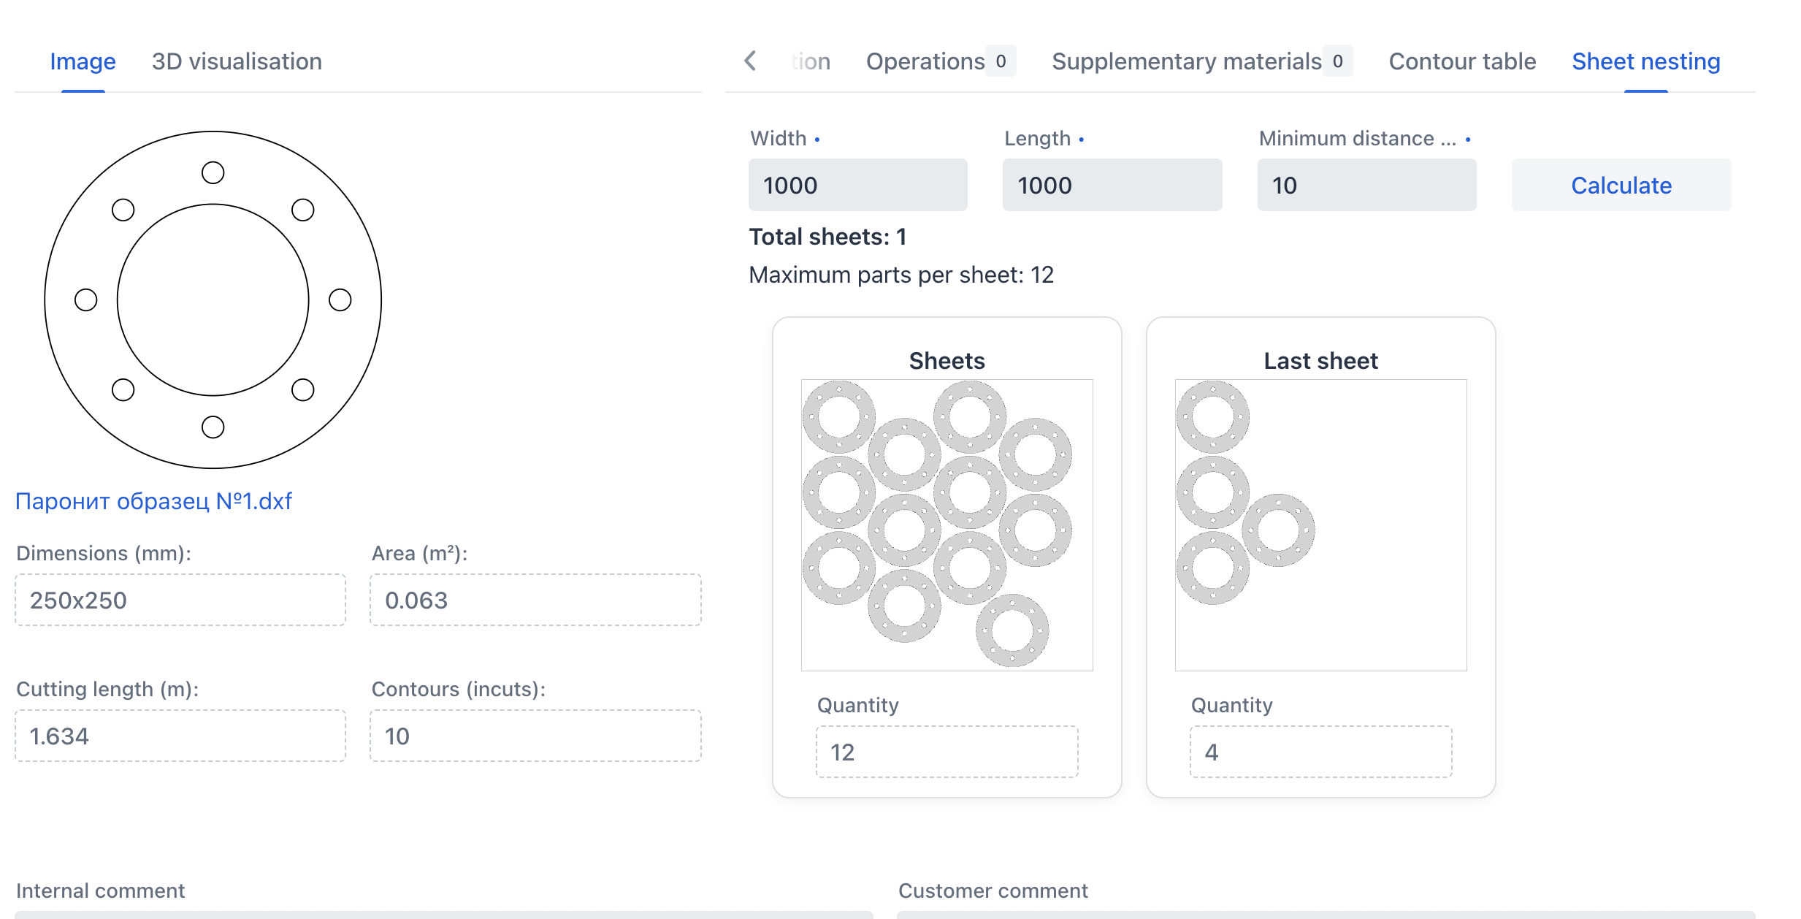





cutl.pro
04
Features
Nesting
Additionally, by specifying the sheet dimensions and space between part you can get a possible layout on the sheet

Slide 5

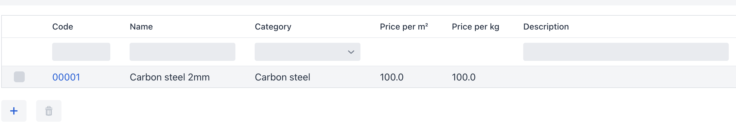
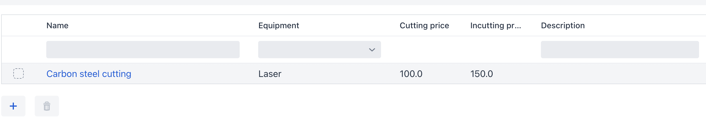
cutl.pro
05
Calculation features
Service provides a way to store
Materials with prices
List of available equipment with cutting modes, cost of each mode and time
IT ALLOWES
01
02
03
04
Create a group calculation (project) for several parts made of different materials
Take into account manual operations and additional materials in the price of the part
Quickly calculate the cost and time of cutting a part from a DXF file
Get summary data on project material consumption

Slide 6

cutl.pro
06
Integration with ERP
You can easily integrate all your projects into your erp system using our API

Slide 7

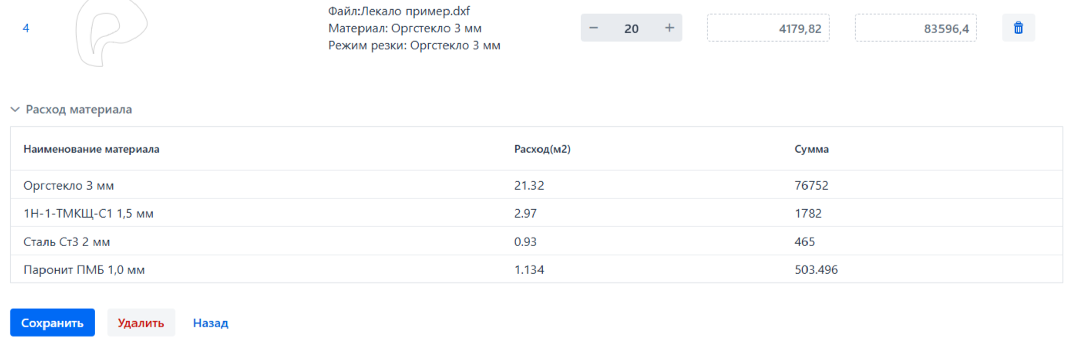

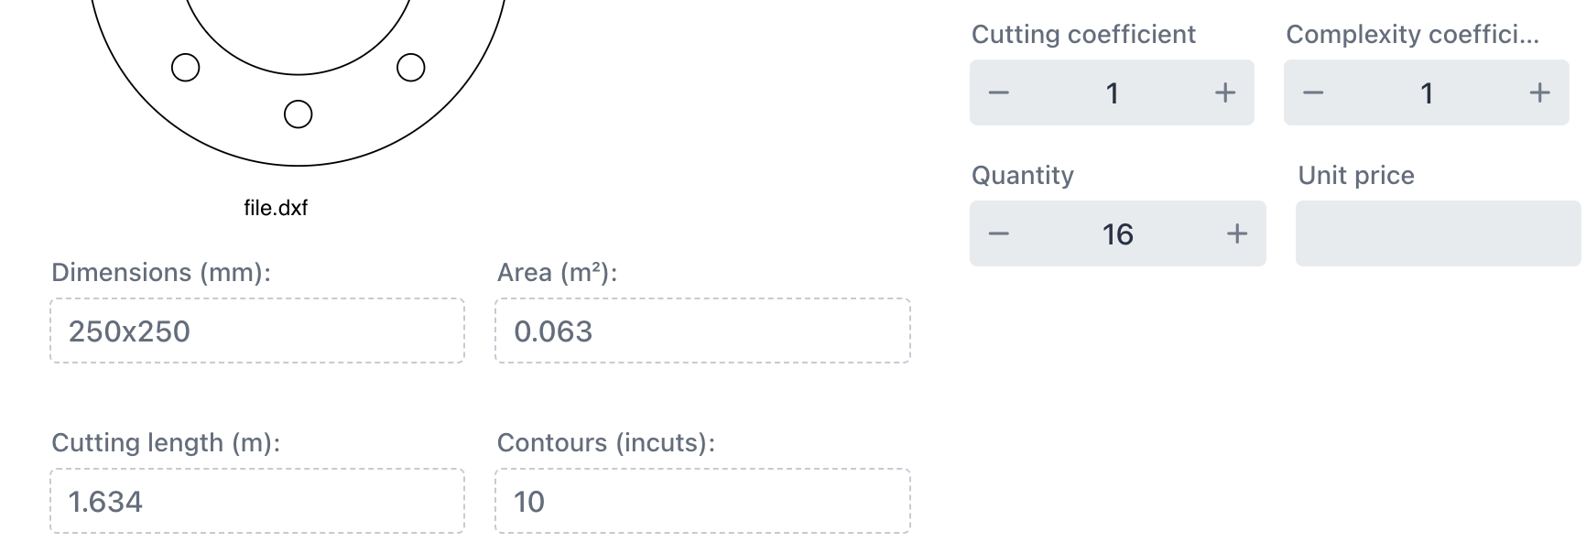
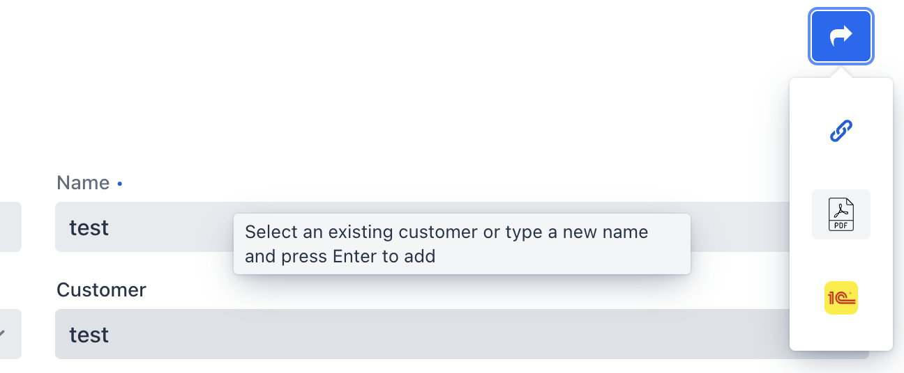
cutl.pro
07
Group calculation features(Project)
What you can do using projects
Get a public shareable link to approve your project with a manager
Get a summary calculation of the consumption of all materials in the project
Send by email or download a commercial proposal in PDF format from the project
Adjust the calculation result of each part (change the contours taken into account, increase the material consumption and take into account the complexity of cutting)
Save detailed calculation results and summary data in PDF

Slide 8











Contact us - we will help you implement CUTL into your process
+31640053622
cutl.online
info@cutl.online

